Slide 1

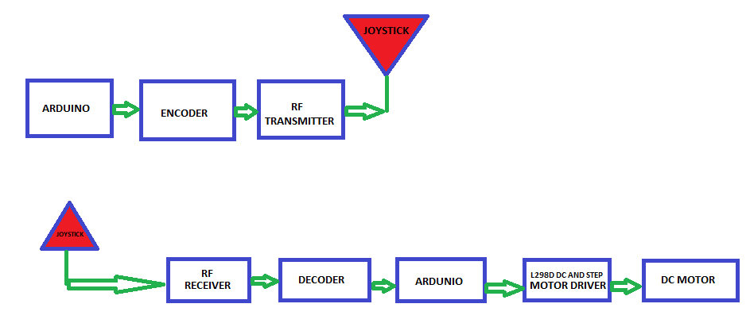
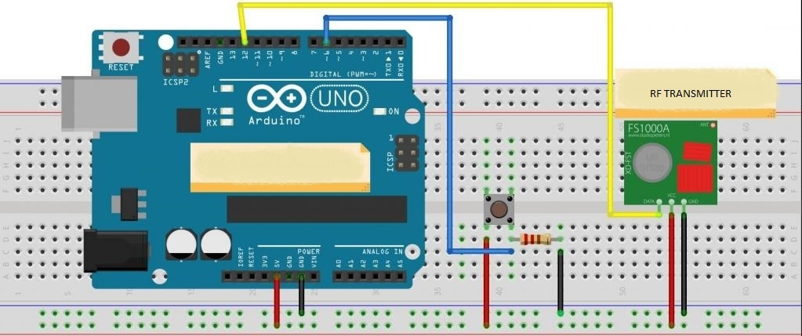
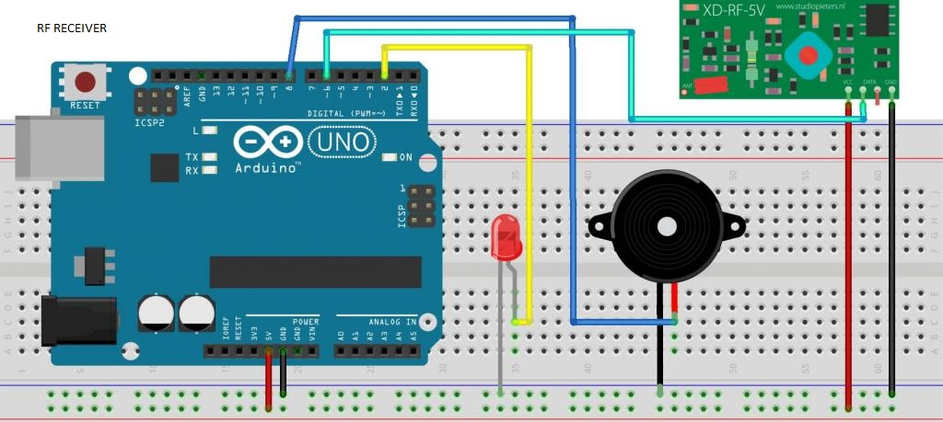
RADIO FREQUENCY REMOTE CONTROLLED
WIRELESS ROBOT
SÜLEYMAN SARI
Supervisor : PROF. DR. NURAN DOĞRU
Department of Electrical and Electronics Engineering, Gaziantep University,Turkey
ABSTRACT
In present time almost all the people are familiar with robots. Robots play a very important role in human life. Robots are a machine which reduces the human efforts in heavy works in industries, building etc. and makes life easy. We have seen many types of Robotic Vehicles like Line Follower Robot, Bluetooth Controlled Robot, DTMF Controlled Robot, Gesture Controlled Robot, etc. but what make the RF Controlled Robot a unique project is it doesn’t use programming to control the robot and the range between the transmitter (remote control) and receiver (robot) can be significantly larger than other types. In this project I've used a 433Mhz RF transmitter modüle pair to allow the Arduinos to communicate wirelessly with each other.These modules are probably the easiest way to set up wireless simplex communincation between two arduinos and are much cheaper compared to other wireless modules.
Flow Chart
Main Components
• ARDUNIO UNO
• RF TRANSMITTER MODULE
• DC MOTOR
Main Board Fritzing Model
MAIN STRACTURE
In the RF controlled car project with Arduino, the car moves by communicating by using two RF modules, the receiver and the transmitter, thanks to the interaction between them. DC motor has been preferred for the movement of the car.
CONCLUSION
In this project, I made with the help of Arduino, the control of the car is provided by the communication of the RF module. The car movement is provided by receiving the signal from the transmitter by the receiver module.
References
https://maker.pro/custom/tutorial/how-to-make-a-radio-controlled-robot-introduction-to-rf-modules
https://www.efxkits.us/radio-frequency-remote-controlled/

